Slide 1
EPAF
Electronic Personnel Action Forms
What is EPAF?
On-line form for student hourly and salary jobs

Slide 2
Use EPAF to…
Set up a student hourly or salary job –
Work study (hourly)
Non-work study (hourly and salary)
Job for international student (hourly and salary)
Change the rate of pay on a student hourly job
Change the Time Sheet Org on a student hourly or salary job
Change the FOAP on a student hourly or salary job
Term a student hourly or salary job (change the job ending date)

Slide 3
Do not use EPAF for…
Temporary positions--University Aides and Technical Professionals
TH9999 & TS9999 positions; contact Human Resources for these jobs.
Involuntary termination of student hourly, salary or work study position.
Please contact Payroll for any involuntary termination of a student employee.

Slide 4
How does EPAF work?
Student job details are entered in EPAF
EPAF uploads job information to Banner system
New job is set up in Banner system or
Change made to existing job (pay rate, etc.)
Student hourly time sheet is created
Student salary amounts can be entered using Banner PHATIME screen

Slide 5
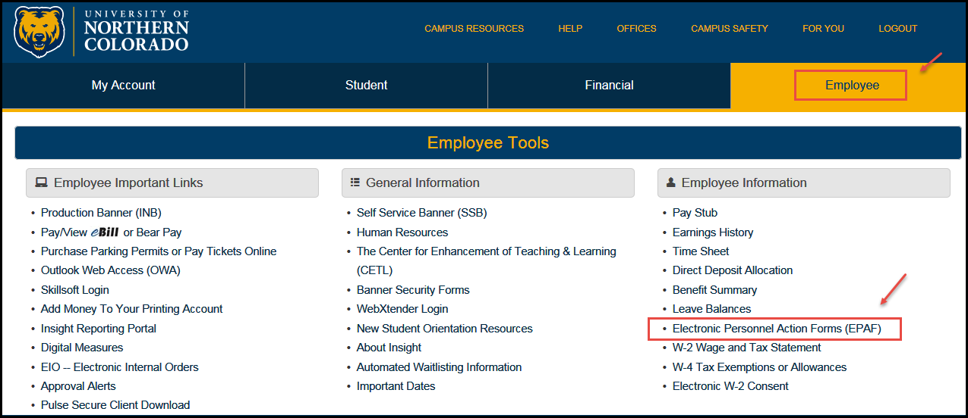
Accessing EPAF:
1. Log into Ursa
2. Click on the Employee Tab
3. Click on the Electronic Personnel Action Forms (EPAF)
You can also access through Employee Dashboard-either way works

Slide 6
4. Click on New EPAF
All EPAFs start with New EPAF

Slide 7
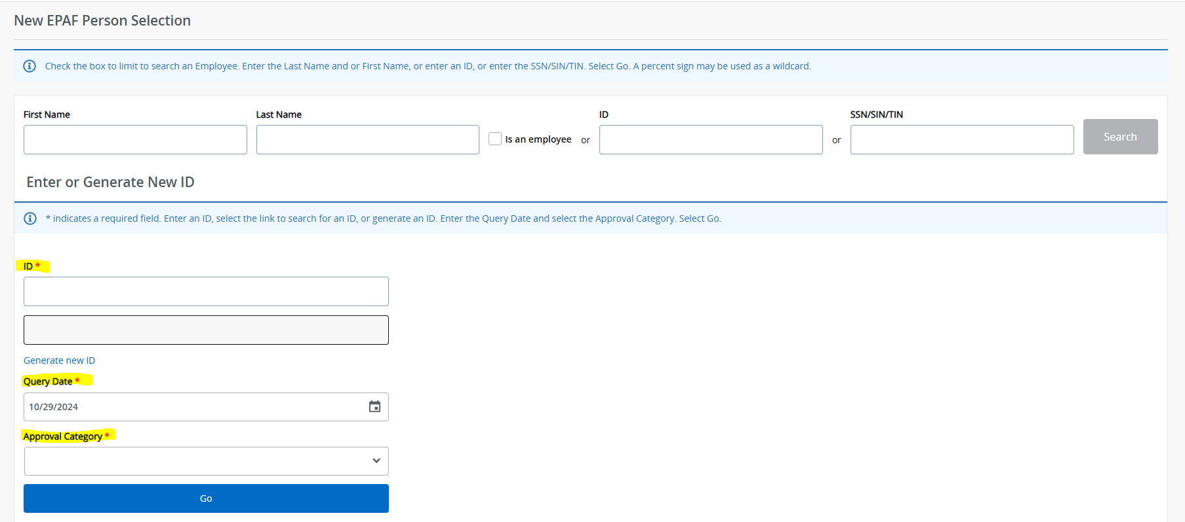
New EPAF Person Selection:
The first steps for all EPAFs:
Enter the student Bear ID, the effective date of the EPAF and select an Approval Category.
Do Not Use this top section

Slide 8
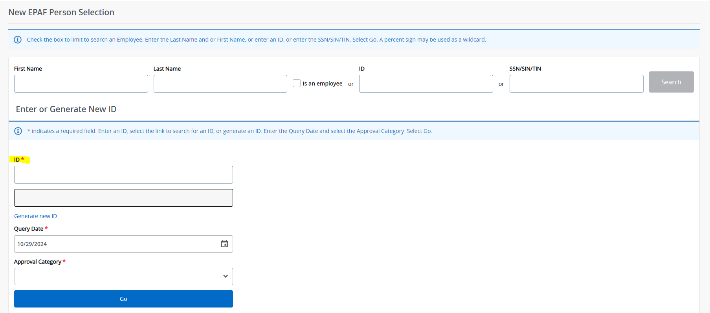
Student’s Bear ID:
1. In the ID field, type in the student’s Bear ID and press the Tab key.
Student’s name will populate.

Slide 9
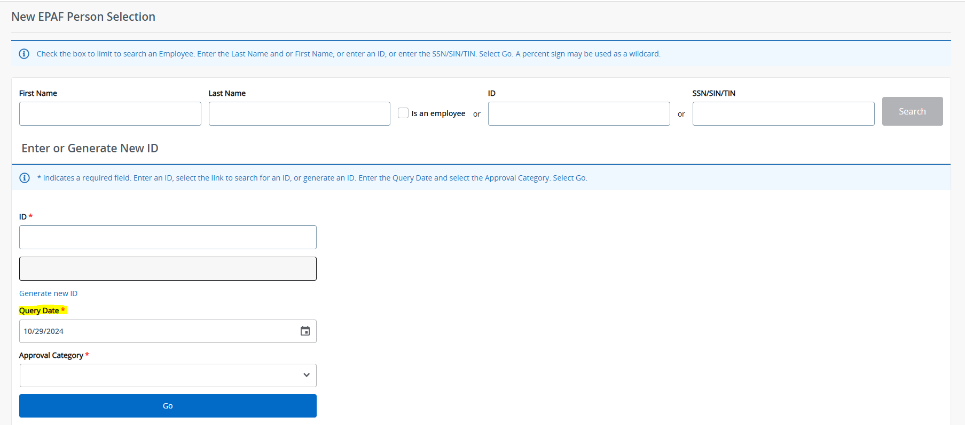
EPAF Query/Effective Date
2. The Query/Effective Date defaults to Today’s date.
Change the Query/Effective date as follows:

Slide 10
Change Today’s date to:
The first day of the work period during which the student begins work either the 1st or 16th.
The Query/Effective Date becomes the starting date for the hourly time sheet.
For pay rate changes, FOAP changes, etc., date must be 1st or 16th.
When terming a job, use the last day of the work period during which the student stops work 15th or last day of the month (30th or 31st).

Slide 11
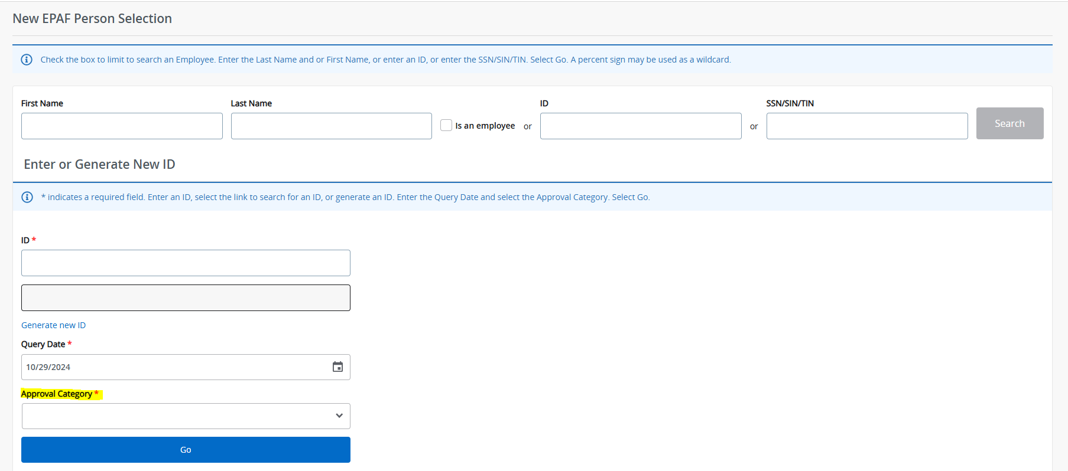
EPAF Approval Category
3. The Approval Category is the type of EPAF - or job action.
Click the Drop Down arrow to see the list of Approval Categories.

Slide 12
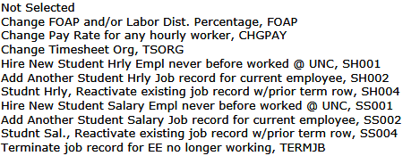
Select the Approval Category

Slide 13
After you select an Approval Category…
Once you select the Approval Category, a list of active jobs for the student is returned.
For a new hire, there should not be any jobs listed.
Click the All Jobs button to see the complete job history for the student, both active and termed jobs.
Review the student’s job history.

Slide 14
Evaluate the Approval Category:
Have I selected the Approval Category I need?
Review the student’s job history.
If there is NO job history, the student is considered a new hire. Make sure you have selected one of the categories for a new hire.
Hire New Student Hourly Employee, SH001
Hire New Student Salary Employee, SS001

Slide 15
Evaluate the Approval Category:
If there IS job history, the student is not a new hire. Make sure you have selected one of the categories for a student who is working or who has worked in the past.
Add a Student Hourly Job, SH002 or
Reactivate a Student Hourly Job, SH004
Add a Student Salary Job, SS002 or
Reactivate a Student Salary Job, SS004
How do I know if I need to Add a job or Reactivate a job?
What does it mean to Reactivate a job?

Slide 16
What is reactivating a job?
Reactivating a job is “re-using” a job by adding new dates and job details to a previously termed job.
Why choose this option?
Keeps student job history to a minimum.
When reactivating, look at job number and suffix.
Make sure the job you select to reactivate is the job number and suffix type (academic year or summer) as the job you will set up.

Slide 17
When to Add a job?
You will Add a job when the job “type” you are hiring a student for does not appear in the student’s job history.
Example: You are hiring a student in a federal work study job and the student’s job history shows they have a non-work study hourly job but no federal work study job(s). You will Add your job as a new federal work study job.
Example: You are hiring a student in a semester salary job and the student’s job history does not show any academic year salary jobs. You will Add your job as a new student salary job.

Slide 18
When to Reactivate a job?
You will Reactivate a job when the job “type” you are setting up matches a previous (termed status) job in student’s job history.
Example: If you are setting up a student hourly job (position SH9999), you can reactivate a previously termed student hourly job (SH9999).
Example: If you are setting up a student salary job (position SS9999), you can reactivate a previously termed student salary job (SS9999).

Slide 19
Select a new Approval Category if needed!
After reviewing the job history, you can select a new Approval Category if needed.
Once you select a new Approval Category, a list of active jobs for the student is again returned.
Click the All Jobs button to see the complete job history for the student.
Use the Radio Button to select the job you need if you are reactivating or making a change to an existing job.

Slide 20
Student Job Numbers:
Student Hourly: SHxxxx
SH9999 Student hourly job, non-work study
SH9996 International student hourly job
SH9997 Colorado State work study hourly job
SH9998 Federal work study hourly job
Student Salary: SSxxxx
SS9999 Student salary job – non-international student
SS9996 International student hourly job

Slide 21
Suffixes for Student Jobs:
The suffix is attached to the job number and distinguishes one job from another.
Each job has its own suffix.
Academic year or semester job uses two numbers:
00, 01, 02, 03, etc.
Summer job uses capital letter ‘S’ followed by a number:
S0, S1, S2, S3, etc.

Slide 22
Proceed with your EPAF: Once you have selected the job to use or new position filled in, click the Go button at bottom to proceed with EPAF data entry. EPAF Data Entry Fields:
* Required fields are noted with a red asterisk.
*(Not Enterable) There is a default value. No data entry is possible.
Magnifying glass search icon. Click on the icon to see a list of values for the field. Values appear in a separate window.

Slide 23
EPAF Data Entry:
There are step-by-step guides for EACH type of EPAF available on the payroll website.
Additional resources for EPAF data entry, available on the payroll website:
EPAF Training Videos
User Guide for Student EPAFs
Setting up Default Routing Queues
EPAF Error Messages
For immediate assistance with an EPAF, contact:
Student Employment at 351-2628 or
Payroll at 351-2705

Slide 24
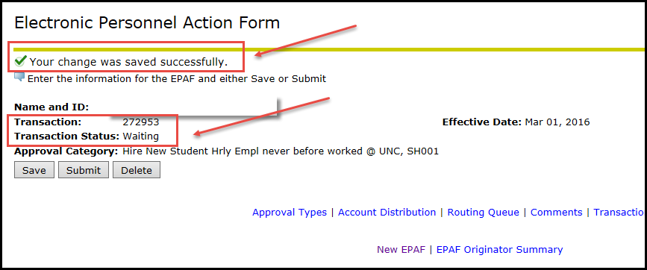
Save your EPAF:
After entering EPAF job details, click the Save button at the bottom of the EPAF.
Look for a new pop up box in green on right side of the EPAF.
The Transaction Status of your EPAF will be “Waiting” and it will be assigned a unique transaction number.

Slide 25
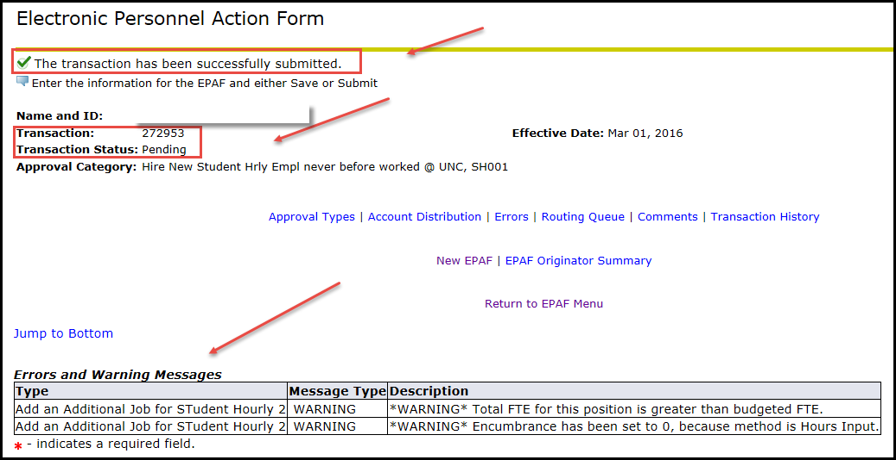
Submit your EPAF:
After saving your EPAF, click the Submit button at the bottom of the EPAF.
Look for a new pop up box in green on the right side of the EPAF.
The Transaction Status of your EPAF will be “Pending”.
“Pending” means that your EPAF has been forwarded to Student Employment for approval.

Slide 26
What happens next?
Warning messages may appear. These are OK and no action is needed.
After you submit your EPAF successfully, it will be reviewed by Student Employment.
This process generally takes 24 hours.
Your EPAF will be approved -- or it may be returned for correction.
You must monitor and check the status of all of your EPAFs – there are no automatic notifications for the process.
Use the EPAF Originator Summary to track your EPAFs.
NOTE: If error messages appear, you will need to correct the errors before your EPAF can be processed.

Slide 27
EPAF Originator Summary

Slide 28
EPAF Originator Summary
There are two tabs: Current and History.
Check the Current Tab and the History Tab under the EPAF Originator Summary to find the status of your EPAF.
It is recommended that you review the EPAF Originator Summary daily until the status of your EPAF changes to Completed.
When the EPAF status is Completed, the job (or job action) has been uploaded successfully to the Banner system.

Slide 29
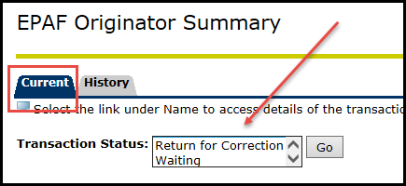
Current Tab
The Current Tab lists EPAFs that are in process, at a Waiting or Returned for Correction status.

Slide 30
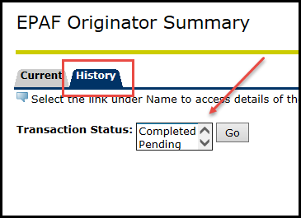
History Tab
The History Tab lists EPAFs that have been successfully submitted. These EPAFs are at a Pending or Completed status.
EPAFs that have been Voided or Cancelled also appear under the History Tab.

Slide 31
When your EPAF is approved:
The status of the EPAF will change from “Pending” to “Approved.”
Once the EPAF is approved, the job will be uploaded to Banner within 24 hours.
When that status of your EPAF is “Completed,” the new job or job action has been uploaded to Banner.
Hourly time sheet is created when EPAF is “Completed”.

Slide 32
If your EPAF is returned for correction:
The status will be changed from “Pending” to “Returned for Correction.”
A comment will be added with information on how to correct your EPAF.
The job will not automatically be uploaded to Banner until corrections are made and the EPAF is re-submitted.
Review the comment added to your EPAF.
Use the Update button to open and update the EPAF and make the necessary corrections. Then, Save and Submit the revised EPAF.

Slide 33
Contacts for EPAF Assistance and Information:
Payroll Department, 351-2700
Student Employment Department,
351-2628
Human Resources Department, 351-2718
For immediate assistance with an EPAF, contact Jeanette Miller at 351-2705 or the payroll office at 351-2700.

