Slide 1
Cumbres Senior Project
Caitlin Quintanilla & Hannah Hartley

Slide 2
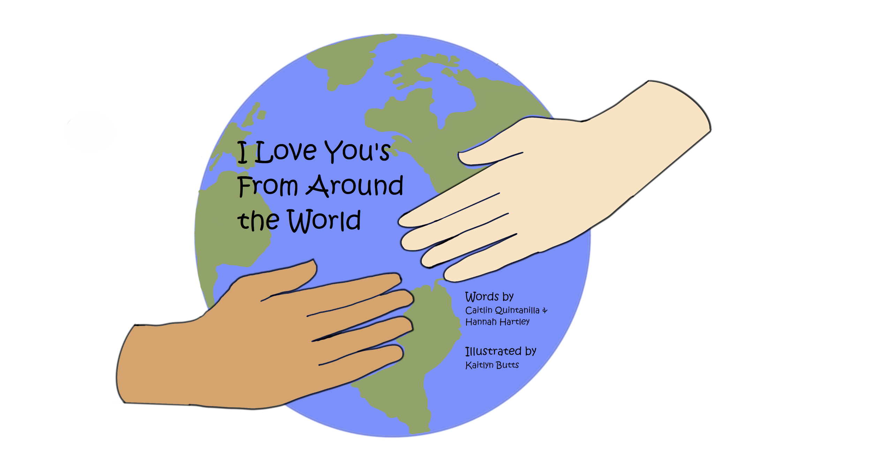
What should we do?
We wanted to do something original, something completely created by us that included languages from around the world. From there, it was easy to decide on creating a children’s book based on the different ways ‘I love you’ was said. It would be easy to write, and easy to create.

Slide 3
The Pandemic Strikes (and other issues)
We wrote the words for the book, but after COVID-19 hit it was difficult to decide what to do with the book. We were hoping to travel to different schools and create a lesson to distribute to teachers across District 6, however when the pandemic hit it was no longer possible to do this. We also had a really difficult time finding artists to illustrate the book. We honestly thought we were going to have to abandon the project. Thankfully, we found an artist and we were able to save the project. Unfortunately, there was nothing we could do about visiting the schools. So instead, we had it published!

Slide 4
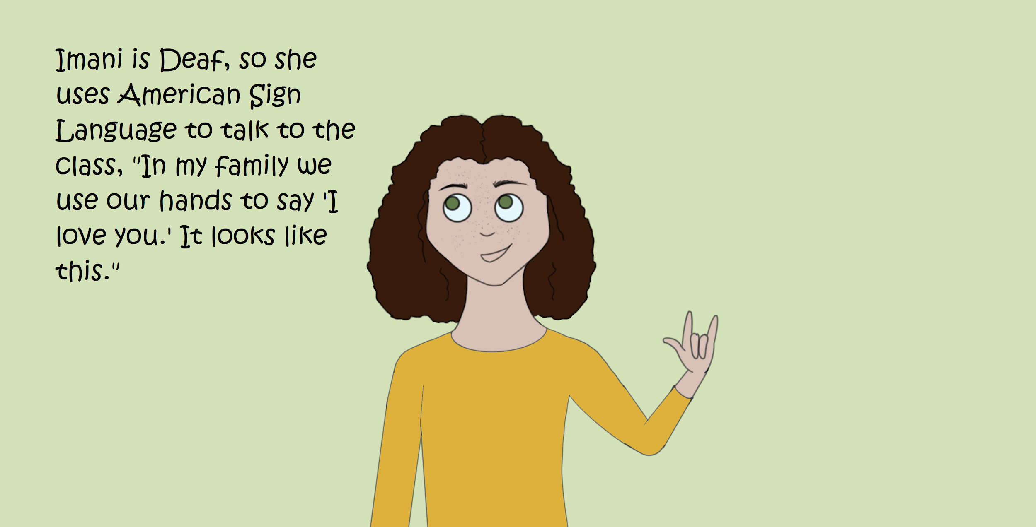
Publishing
We used Kindle Direct Publishing in order to make it accessible for everyone during the pandemic. And if we ever wanted to, we could use the same company to create physical copies as well. It was a great way to distribute the book during a global pandemic, and it gave us experience with using publishing site!

Slide 5
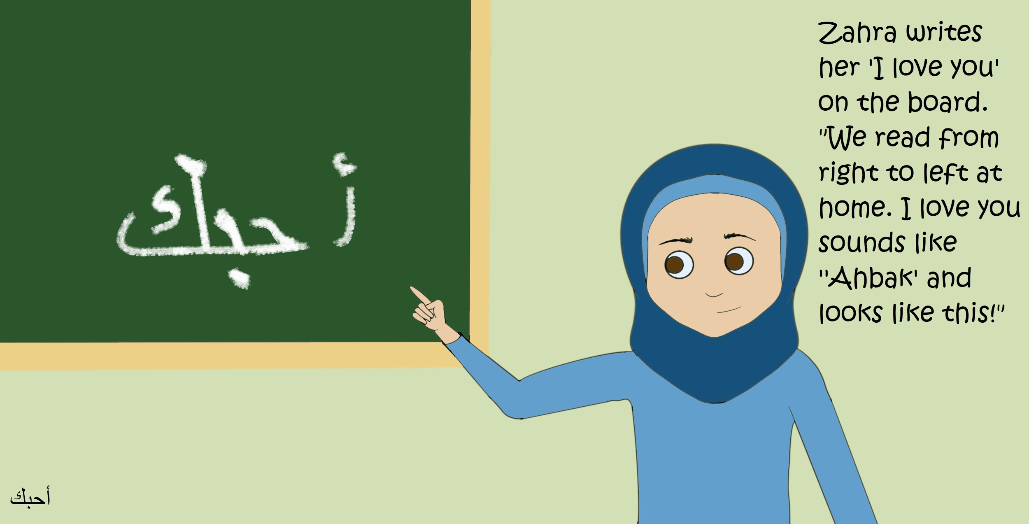
Final Product
We’re Published!
You can currently download our children’s book “I Love You’s From Around the World” on Amazon! The book is $0.99, unfortunately KDP did not allow for the content to be free, and is public domain so anyone can use any parts of it for anything they would like. The sources we used for the book were either native speakers or had access to native speakers, so each and every translation is verified. We would love for you all to use it in your classrooms when you are all teachers :) And of course you can get a free copy, just email either one of use and we can send you a free copy!

