Slide 1

Emerald Ash Borer Threat
City of Greeley Forestry

Slide 2

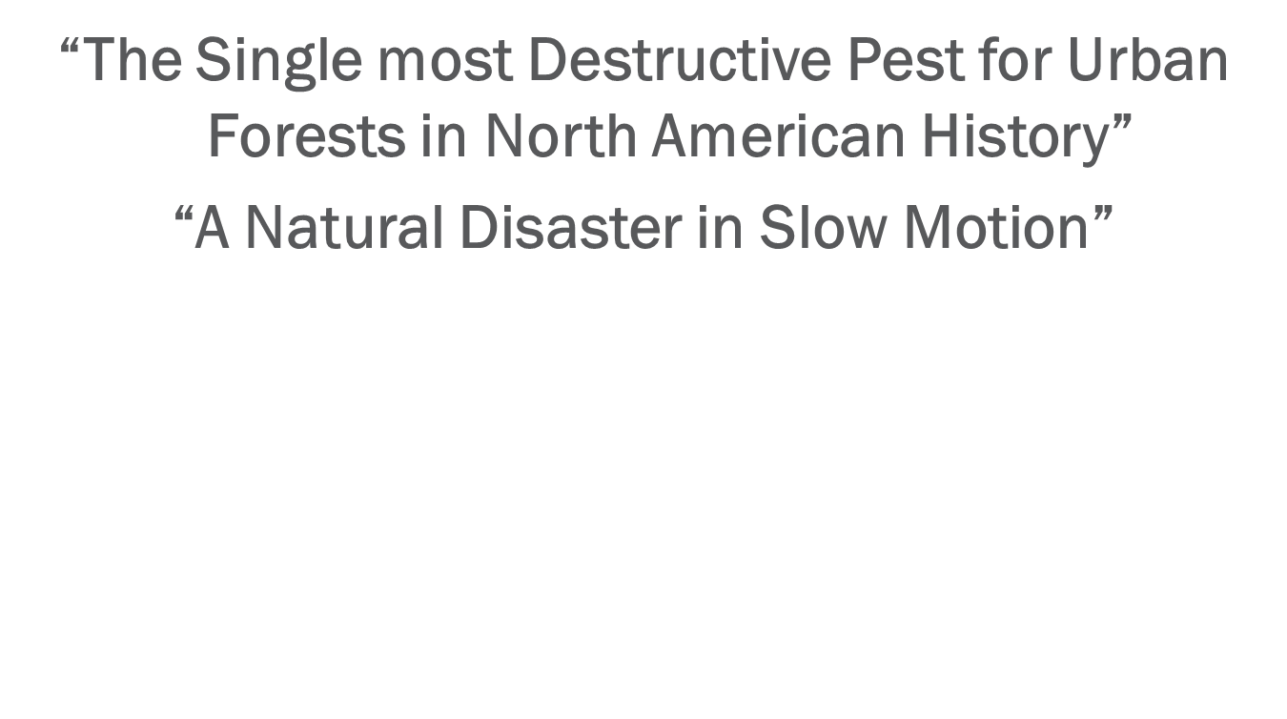
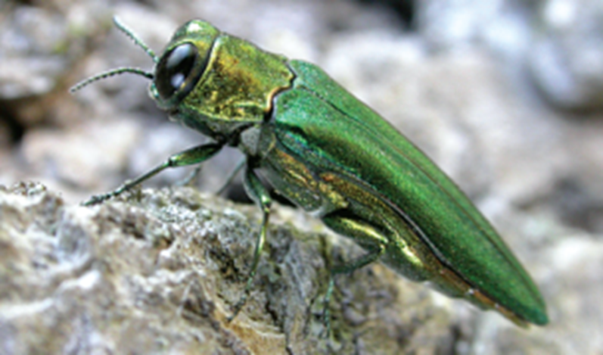
Emerald Ash Borer

Slide 3
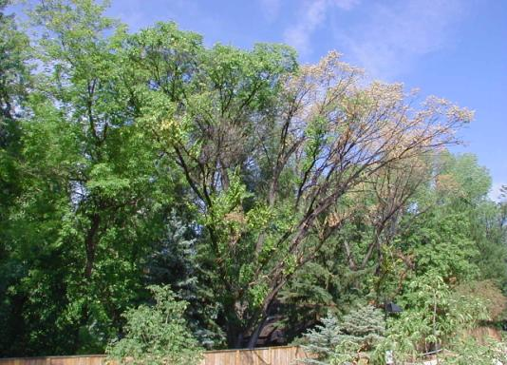
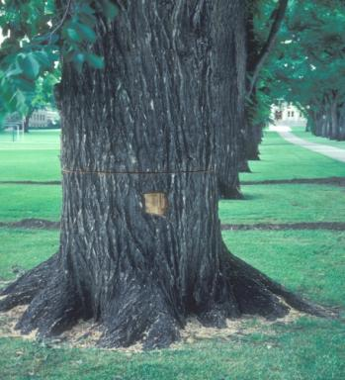
Dutch Elm Disease
Dutch Elm Disease (American elms)
  50,000 American elms across Colorado prior to introduction
  30,000 (60 percent) American elms removed between 1973 - 2012
  Management = prompt tree removal and proper wood disposal

Slide 4
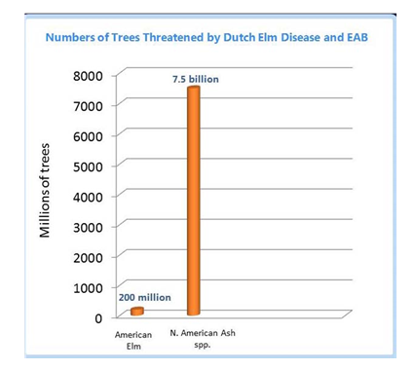
North American Tree Totals

Slide 5
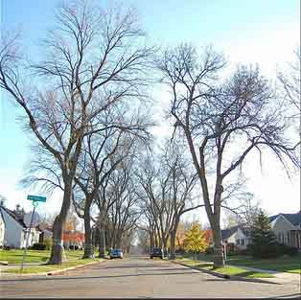
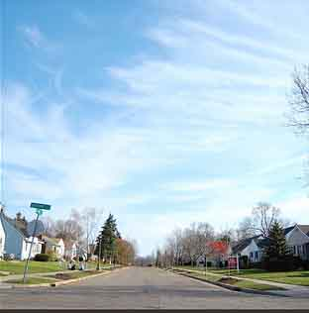
Challenges to Staff
Private Trees
  Managing code enforcement volume, contractor licensing, outreach
Public Tree Care Operations
  Number of removals and increased plantings may limit ability for pruning and other duties
Weighing Treatment versus Removals

Slide 6
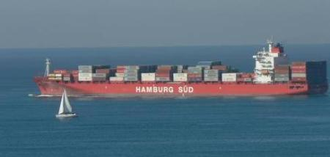

Pest Origins
  EAB first identified in Michigan in 2002
  Introduced from east Asia
    - Probably infested shipping or packing material
  Initial introductions likely in the 1990’s

Slide 7
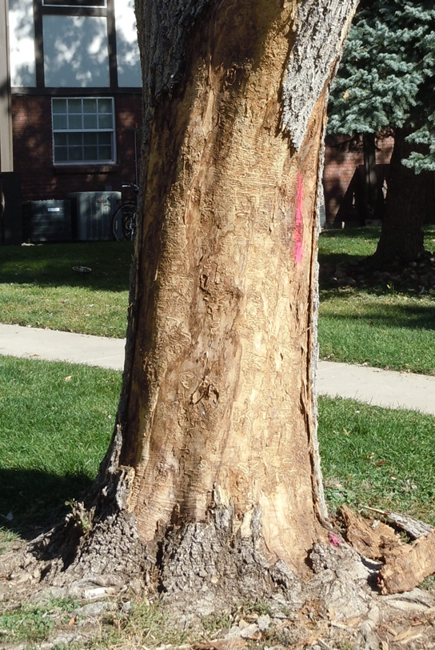
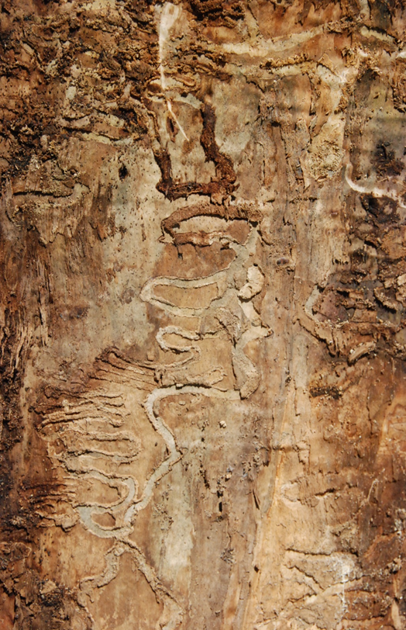
What does it do?

Slide 8
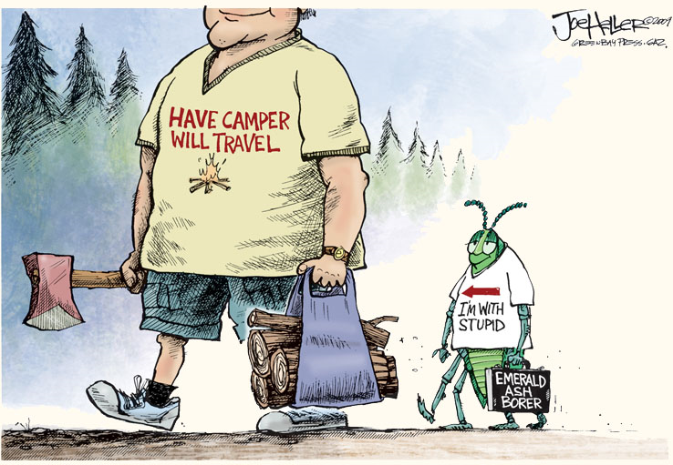
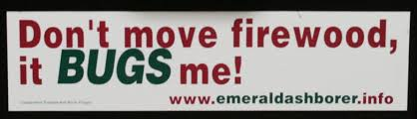
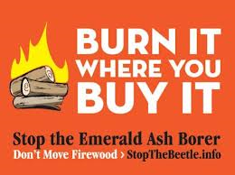
How did it get here?

Slide 9
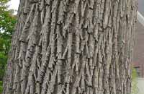
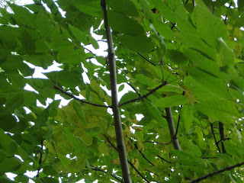
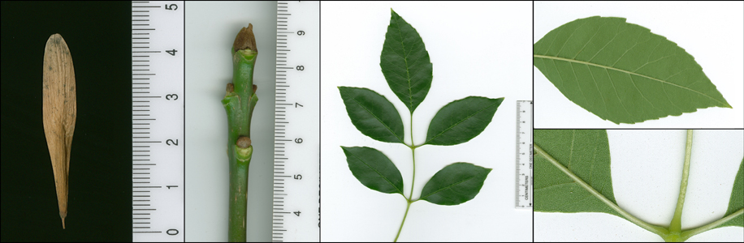
Do I have an Ash Tree?

Slide 10
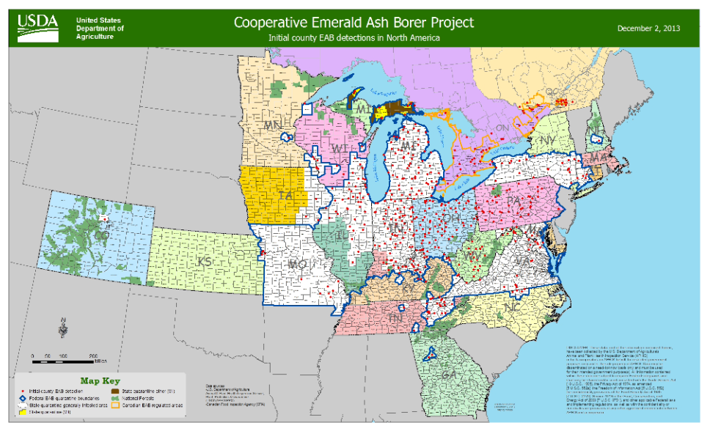
Where is Emerald Ash Borer?

Slide 11
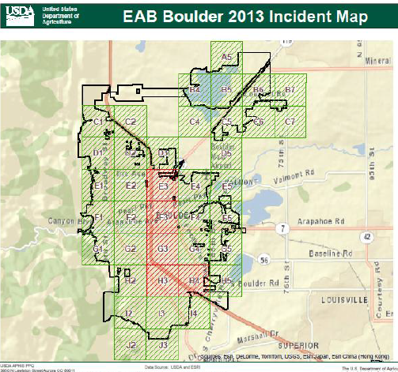
Where is Emerald Ash Borer?
Emerald Ash Borer is estimated to have been in Boulder for 3-4 years before it was detected late last year

Slide 12
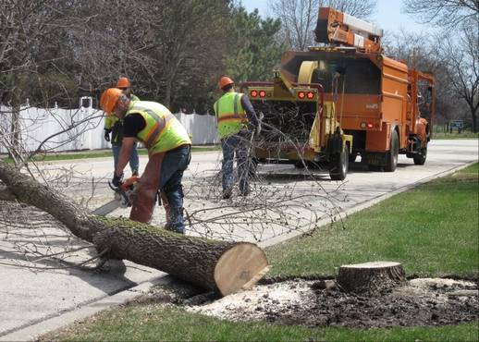
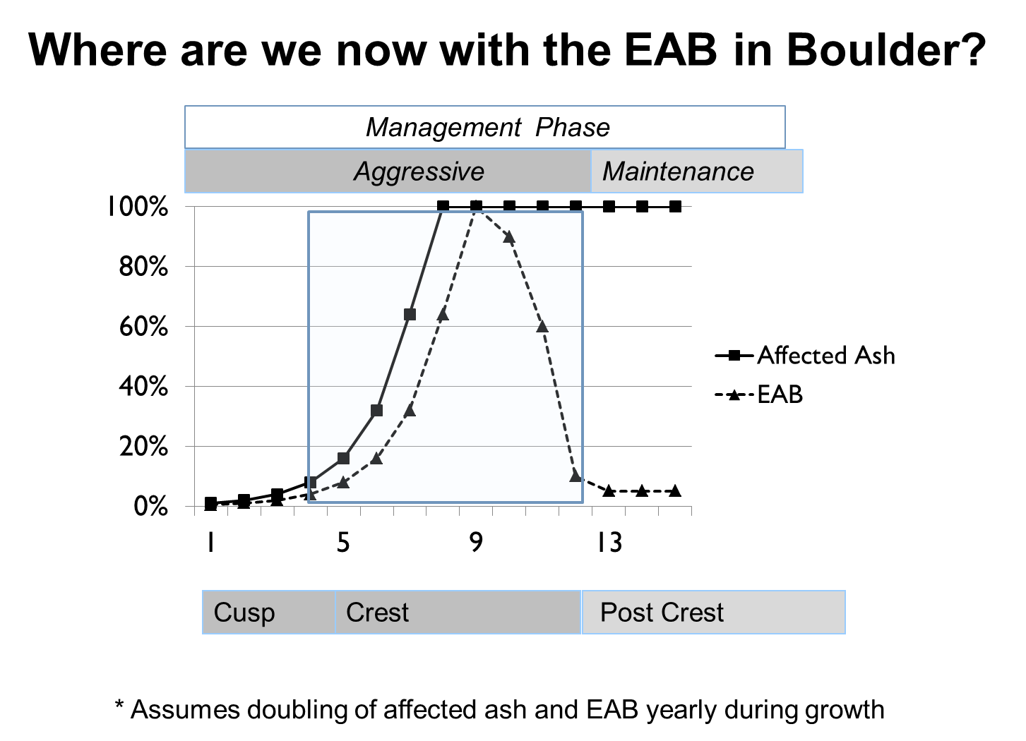

Can the Ash Be Saved?
  Ash - 100% will die if not treated with pesticides
  Pesticide must be administered until EAB populations decline
  EAB populations expand exponentially
  When untreated, entire ash populations in Midwest communities were beyond treatment after 10 years

Slide 13
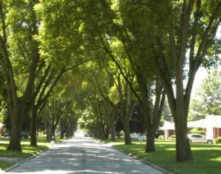
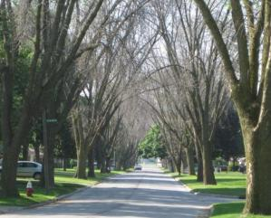
Impact in Urban Areas
$10.7 Billion in 25 states for treatment, removal and replacement of more than 17 Million ash trees on developed land
Loss of $3 Billion in property value and ecological services (Ohio only)
June 2006
August 2009

Slide 14
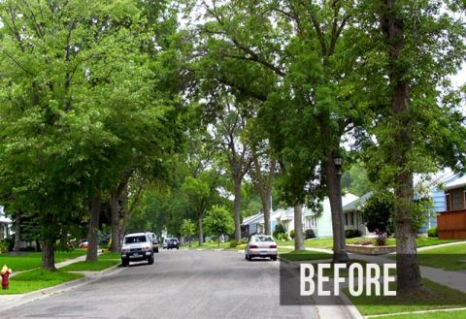
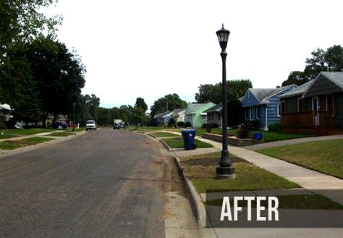
Impact in Urban Areas
Tree removals ($450/tree avg dbh 12”)
Tree replacements ($400/tree)
Additional costs
  Pesticide treatment, wood disposal
  Property value, economy, landscape watering, storm-water runoff

Slide 15
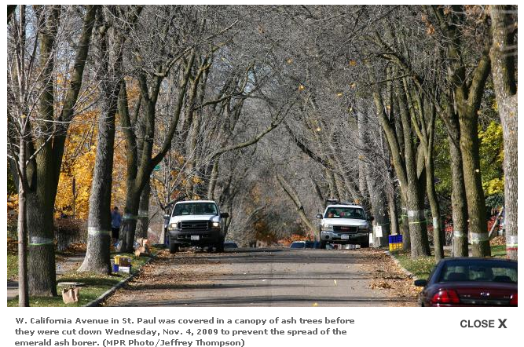
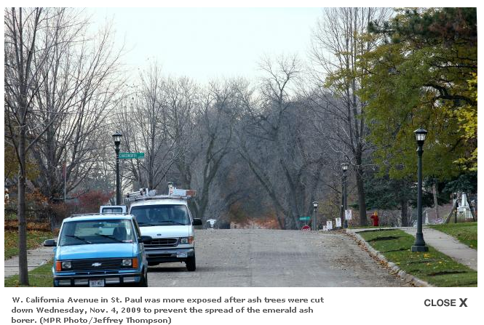
Impact in Urban Areas
Economic
Property values
Business activity
Quarantine impacts
Social
Quality of life
Neighborhood character
Aesthetics and shade
Environmental
Energy savings
Storm water interception
Air pollutant removal
Waste disposal

Slide 16
How Many Ash Do We Have?
10% of Greeley’s public trees (parks) are ash
30% of right-of-way trees are ash

Slide 17
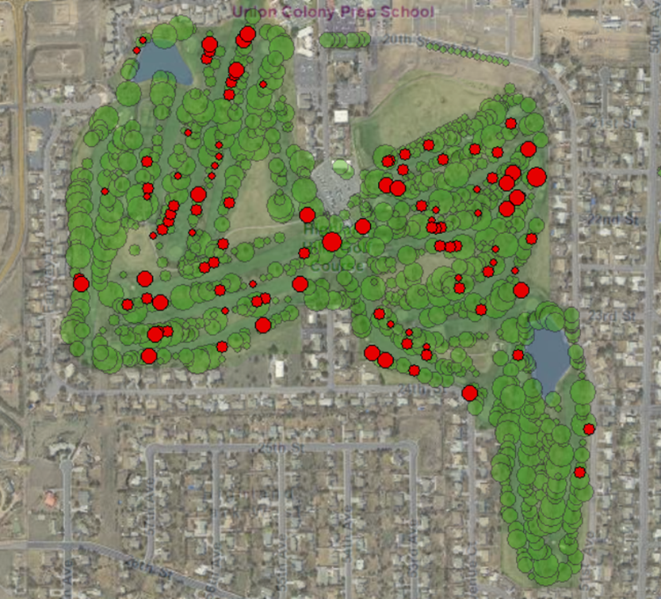
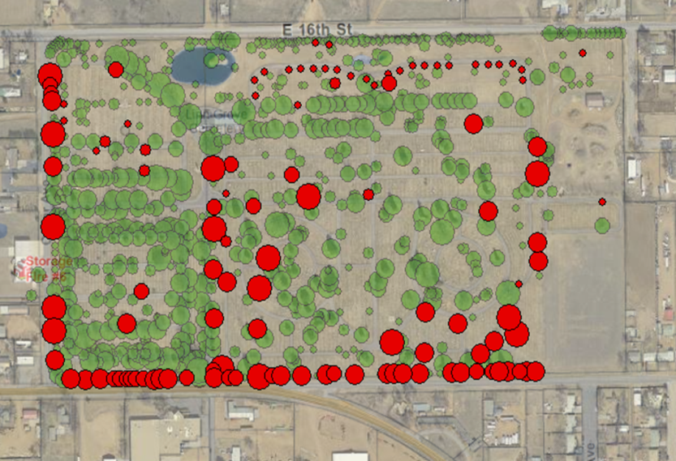
Public Ash Trees
Highland Hills Golf Course:
-Already losing 20-30 large trees/year
Linn Grove Cemetery:
-Solid line of ash along 18th Street
Lincoln Park:
- Arts Picnic

Slide 18
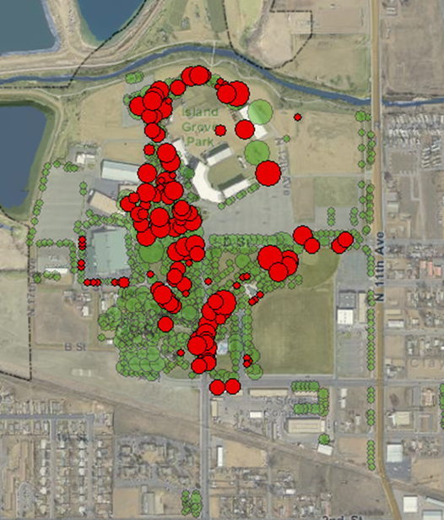
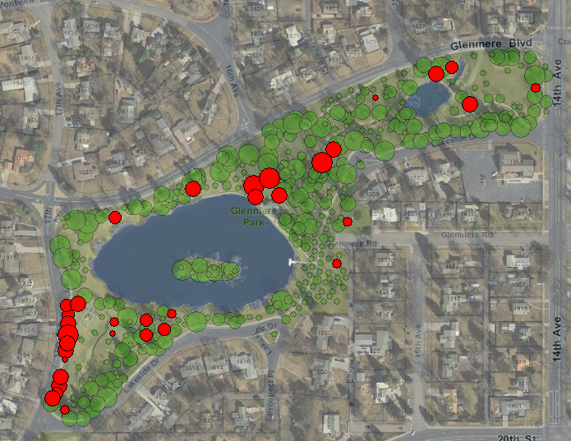
Public Ash Trees
Island Grove:
-Stampede
-County Fair
Glenmere
- Premier park
- 1 in 9 trees are ash
Promontory
-Highest proportion ash

Slide 19
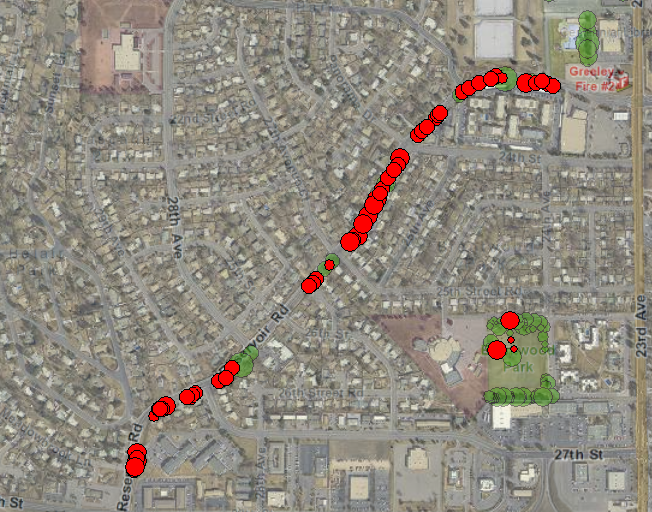
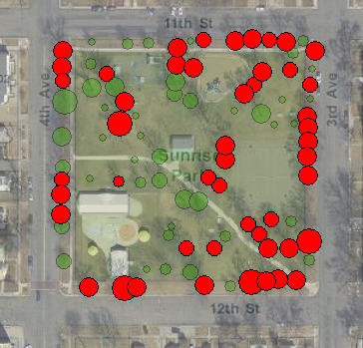
Public Ash Trees
Reservoir Rd. Bike Trail
- 85% ash
Sunrise Park
- 53% ash
Monfort Park
- Large # of ash in a newer park

Slide 20
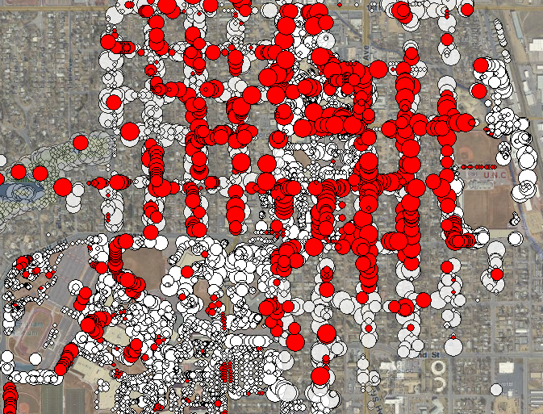
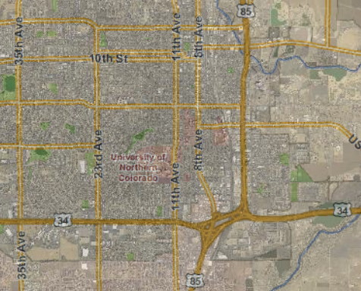
Private Ash Trees
Street Tree Population
- 30% ash
Entire Tree Population?
- Likely 15% ash

Slide 21
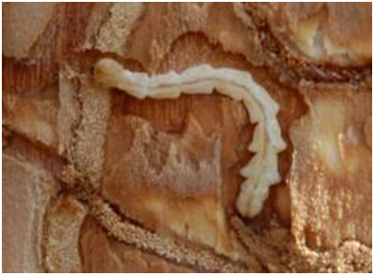
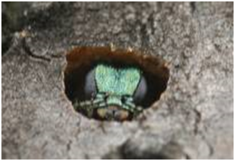
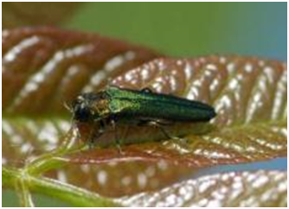
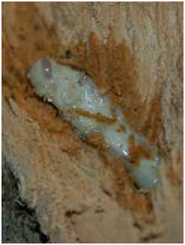
EAB Management Plan
Education
Budget
Outreach
Action
Sampling
Classification
Planting
Budget
Diversity
Messaging
Collaboration
Messaging
Numbers
Education
Logistics
Disposal
Disposal

Slide 22
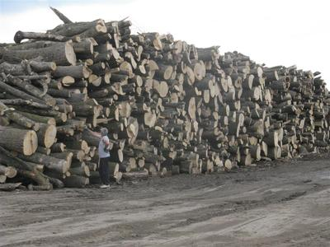
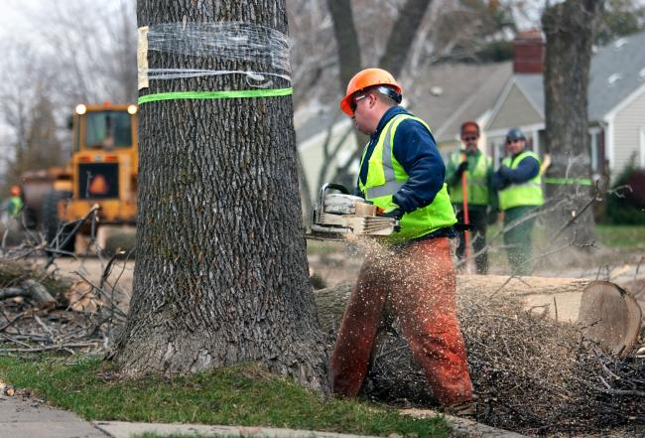
Education
Forecast Budget Impacts
Outreach to: Administration, Council, Evans, UNC, AIMS, District 6, HOA’s, Citizens, Media, etc.
Messaging
Disposal/Quarantine

Slide 23
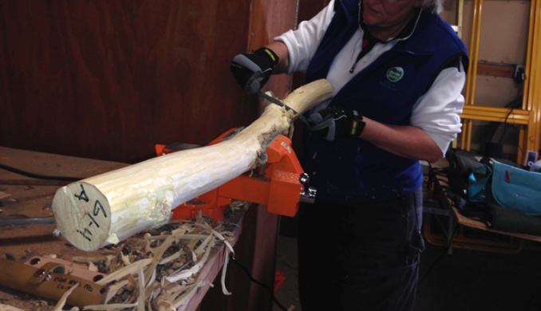
Action
Sampling
Inventory/Classification
Collaborate: Evans, UNC, AIMS, DIST 6, HOA’s
Messaging
Disposal

Slide 24
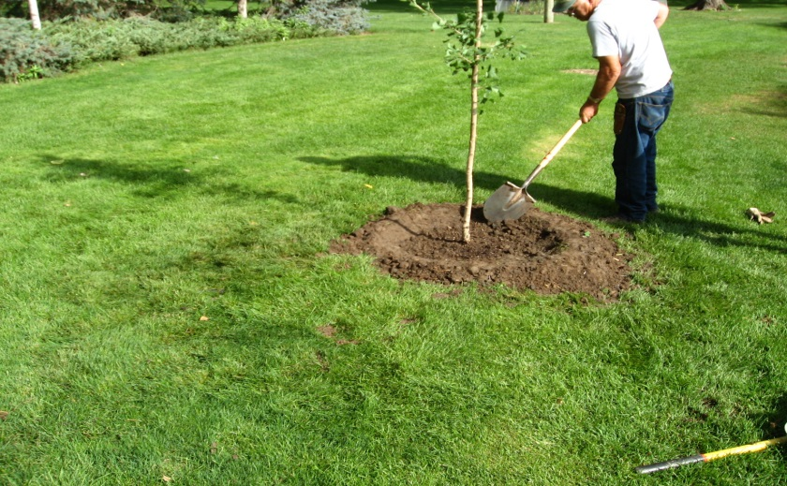
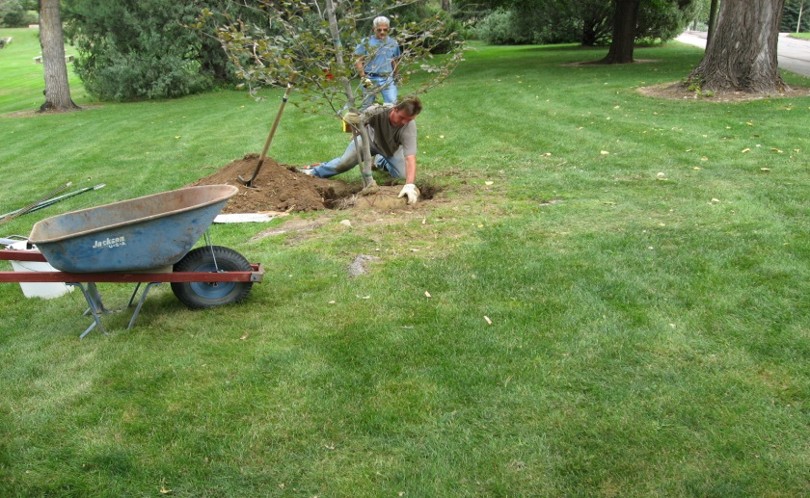
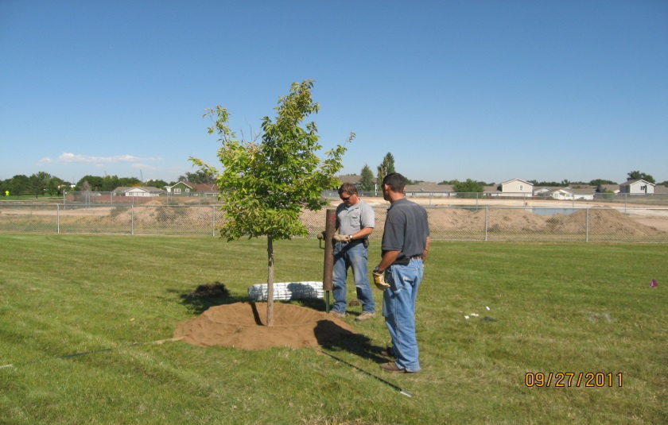
Planting
Budget
Diversity
Numbers
Education/How To
Logistics

Slide 25
Contact Greeley Forestry
With Any Questions
Office Number (970) 339-2405
www.greeleyforestry.org
emeraldashborer.info
eabcolorado.com

